Slide 1
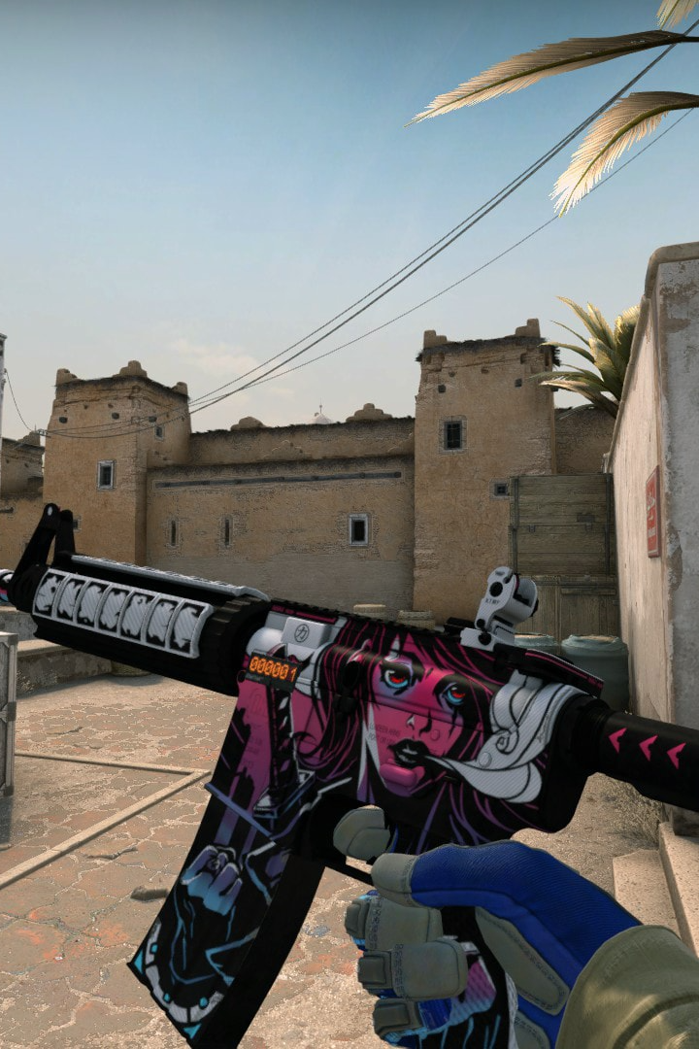
AMITY SCHOOL OF ENGINEERING AND TECHNOLOGY
Supervised Learning in CSGO Round Winner Prediction
PRESENTED BY :
KUNAL SLATHIA
M.TECH (DSE)
3RD SEM.
7th November ,2023

Slide 2
INTRODUCTION
CS:GO is a popular first-person shooter (FPS) game known for its competitive gameplay and global esports presence. It features teams of terrorists and counter-terrorists engaging in tactical encounters
across various maps.
The core objective of this project is to employ supervised learning techniques for developing and comparing predictive models for classifying round winners in CS:GO.

Slide 3
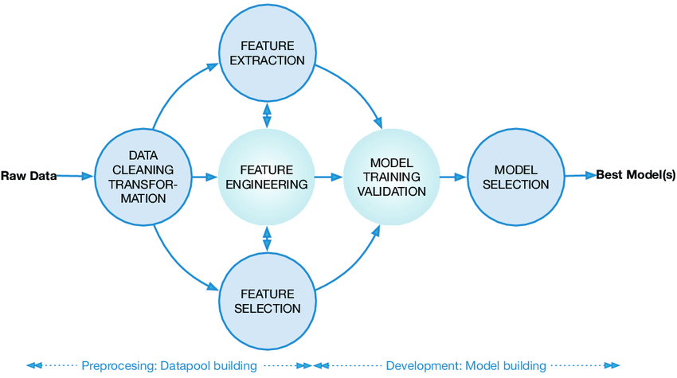
METHODOLOGY
Data Collection and Preprocessing
Feature Engineering
Model Selection
Model Training and Evaluation
Implementation and Results

Slide 4

Data Collection and Preprocessing
The dataset used in this project was obtained from Kaggle
The dataset encompasses a diverse range of attributes, including information on time remaining in a round, team scores, map being played, and player statistics.
Thorough examination of the dataset revealed completeness with no missing or null values.
Standardization of numerical attributes using a Standard-Scaler ensured data was on a common scale.

Slide 5

Feature Engineering
Feature engineering enhances predictive model accuracy by transforming raw data into meaningful features.
Label Encoding: Converts categorical variables into numerical equivalents, making them compatible with machine learning algorithms.
Feature Selection:
Linear Discriminant Analysis (LDA) used for dimensionality reduction.
LDA identifies the most discriminative features by projecting data onto a lower-dimensional subspace.
Top 20 features with highest importance scores selected for model training and evaluation.

Slide 6
Model Selection
Logistic Regression: Predicts the probability of a binary outcome.
Decision Tree: Uses a tree-like model of decisions to predict the outcome.
Random Forest: Aggregates multiple decision trees for robust predictions.

Slide 7

Model Evaluation
Overview of the evaluation process:
Dataset split into training and testing sets (80% - 20%).
Models trained on the training set, evaluated on the testing set.
Performance metrics used:
Accuracy, Precision, Recall, F1-Score.
Provide comprehensive assessment of model performance.
Presentation of results:
Comparative analysis to identify the most effective approach.
Random Forest demonstrated highest accuracy and predictive power.

Slide 8

Implementation and Results
Practical implementation of the project:
Utilized machine learning techniques for round winner prediction in CS:GO.
Key Findings and Insights:
Random Forest Classifier demonstrated highest accuracy and predictive power.
Feature importance analysis revealed critical attributes influencing round outcomes.

Slide 9
Results Summary:
Counter-Terrorist (CT) Class
Precision : 0.86
Recall : 0.85
F1-Score : 0.85
Terrorist (T) Class
Precision : 0.86
Recall : 0.86
F1-Score : 0.86

Slide 10
Conclusion
Summary of Findings
Successful application of supervised learning for round winner prediction in CS:GO.
Random Forest Classifier emerged as the most effective model.
Recommendations for Future Work:
Implement predictive model in esports analytics platforms.
Continuously update dataset for ongoing effectiveness.
Conduct hyperparameter tuning for potential performance improvements.

Slide 11

Youyout
THANK
YOU

